Slide 1
Presentation task - MOK Library
Csaba Selmeczi and Ákos Jernei

Slide 2
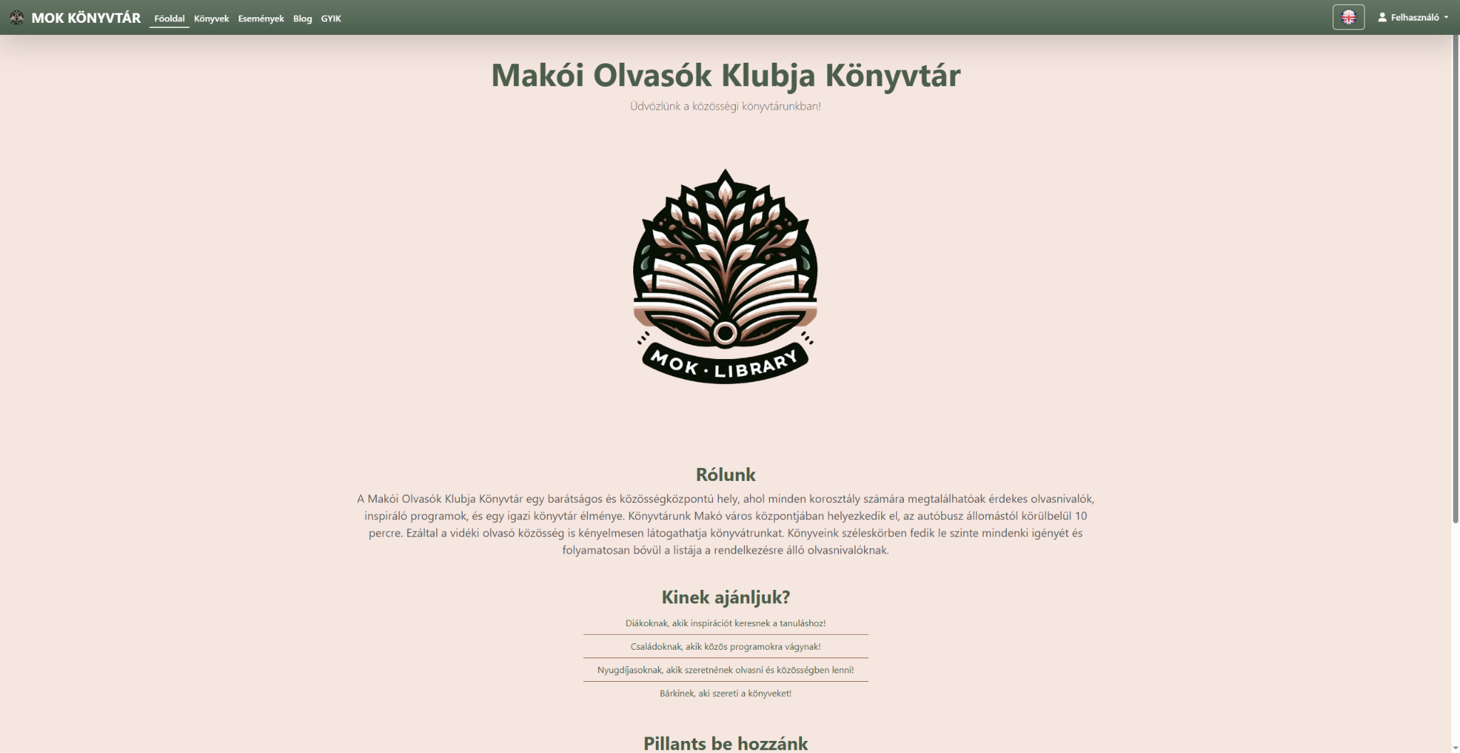
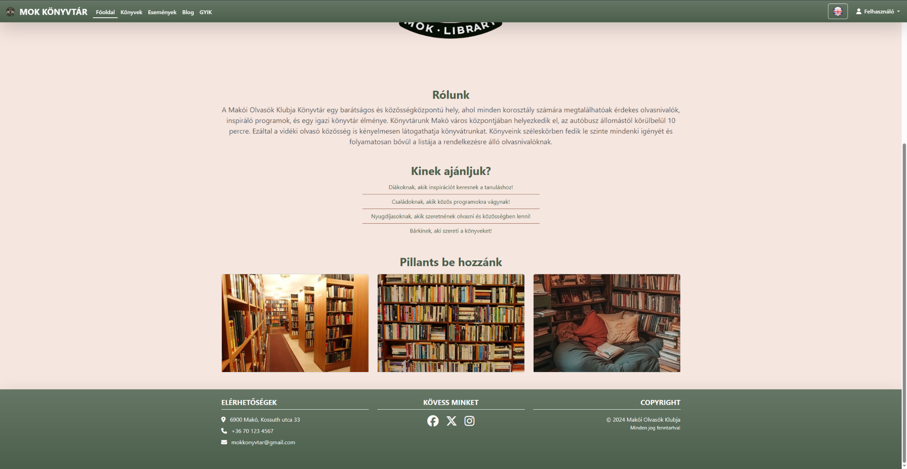
About our project and the main page
Our project is the complete digitalization of a library. On the main page you can see a short description of the library. The site is navigated using a navigation bar. The navigation bar contains the navigation buttons, a language change button which is still under construction, and the user menu. In case of collapse, it is replaced by a burger icon. The website is 100% responsive to provide the maximum experience on all devices.

Slide 3
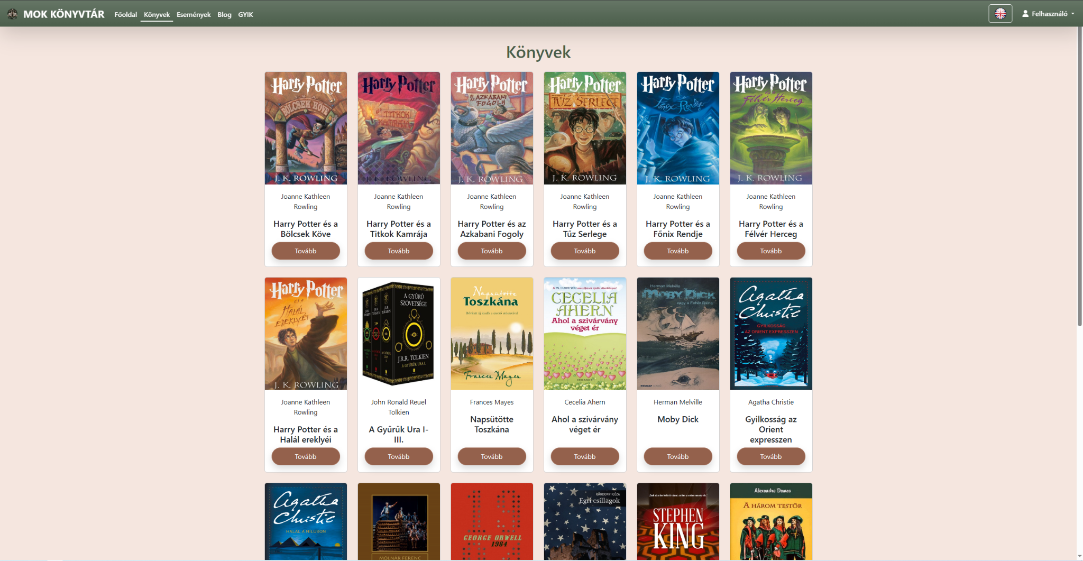
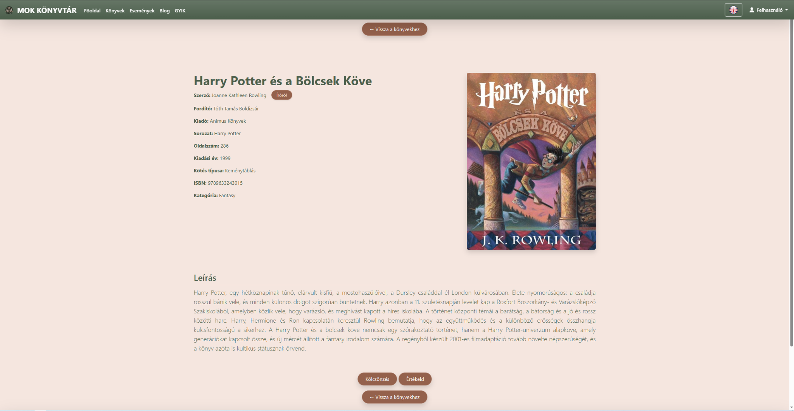
Book pages and related features
The list of books is dynamically generated from a database (as is almost everything on our website). By going to the webpage of the selected book, the user can find out everything about the book. A separate button also provides information about the author. For the user's convenience, we have placed back buttons at the top and bottom. At the bottom you can see the book rental and review buttons which are not yet functional. These functions are only available to logged in users.

Slide 4
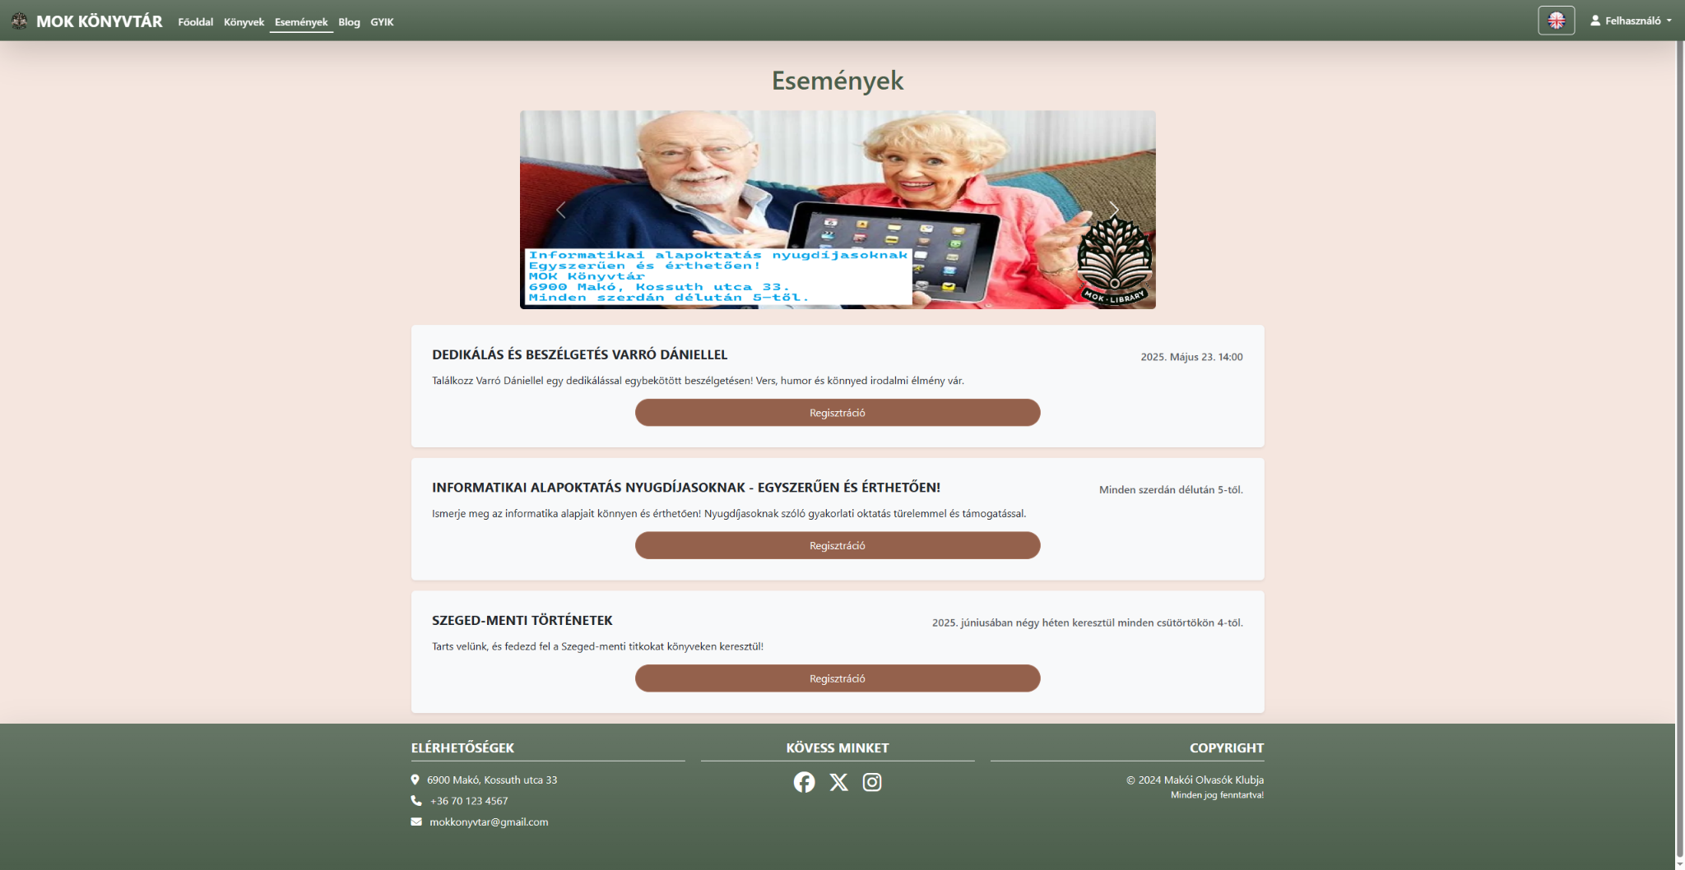
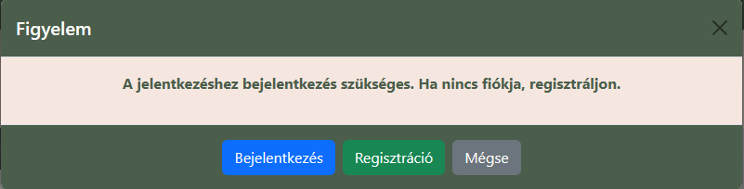
Events page
Here, the user can see the advertised programmes and, if they are registered, they can book a place. This feature is also currently under development, but it is now also set up so that only registered users can register. If they are not registered, a pop-up window will take them there.

Slide 5
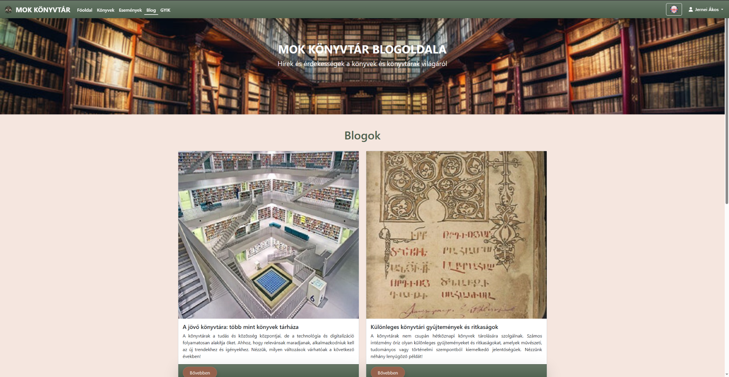
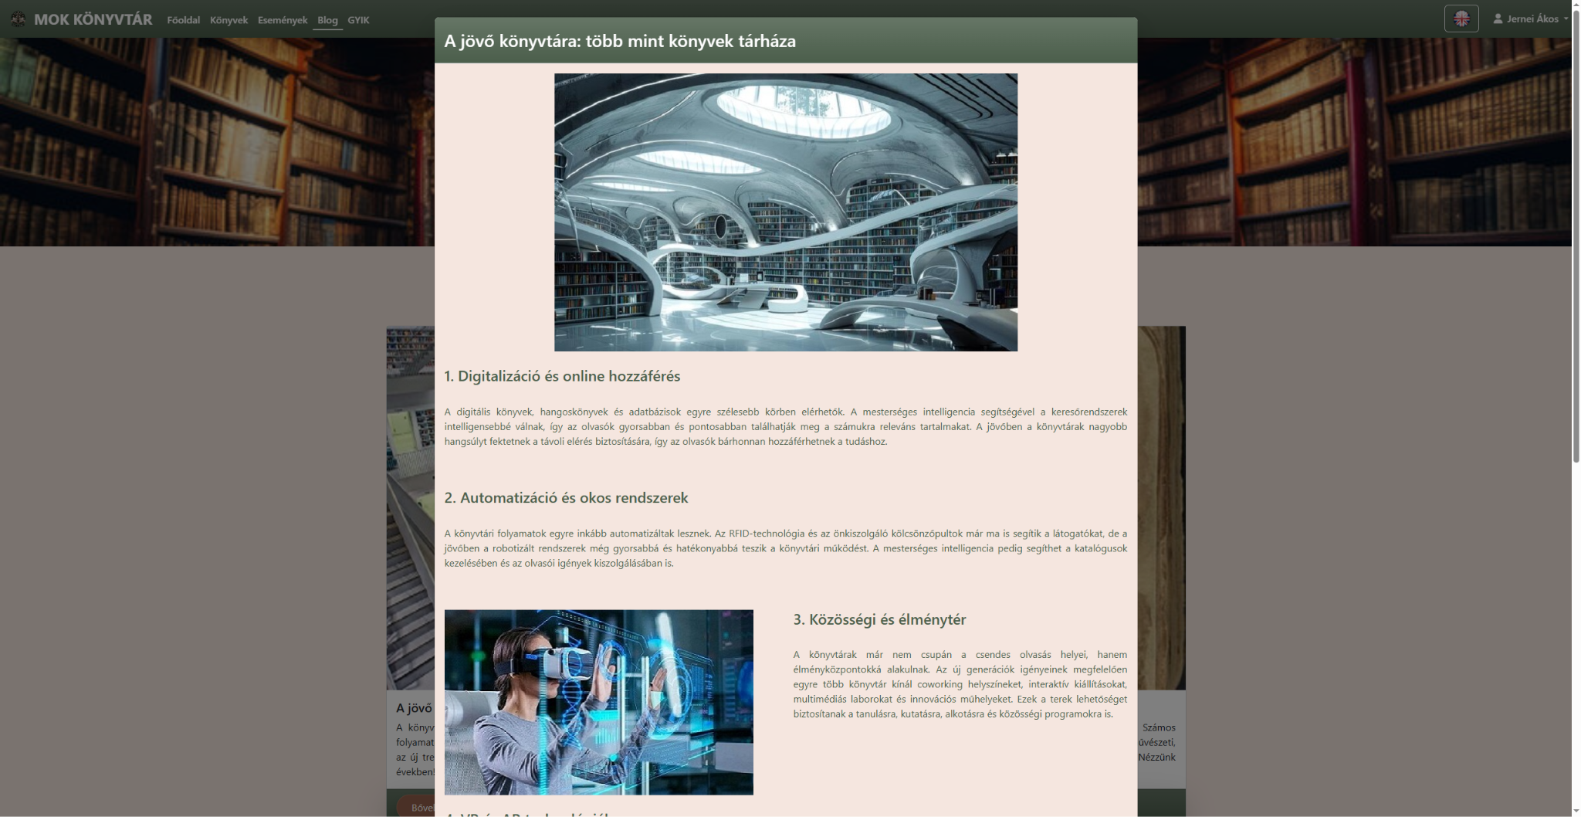
Blog page
On the blog page, visitors can read news, articles and interesting facts about the library, books and literature.

Slide 6
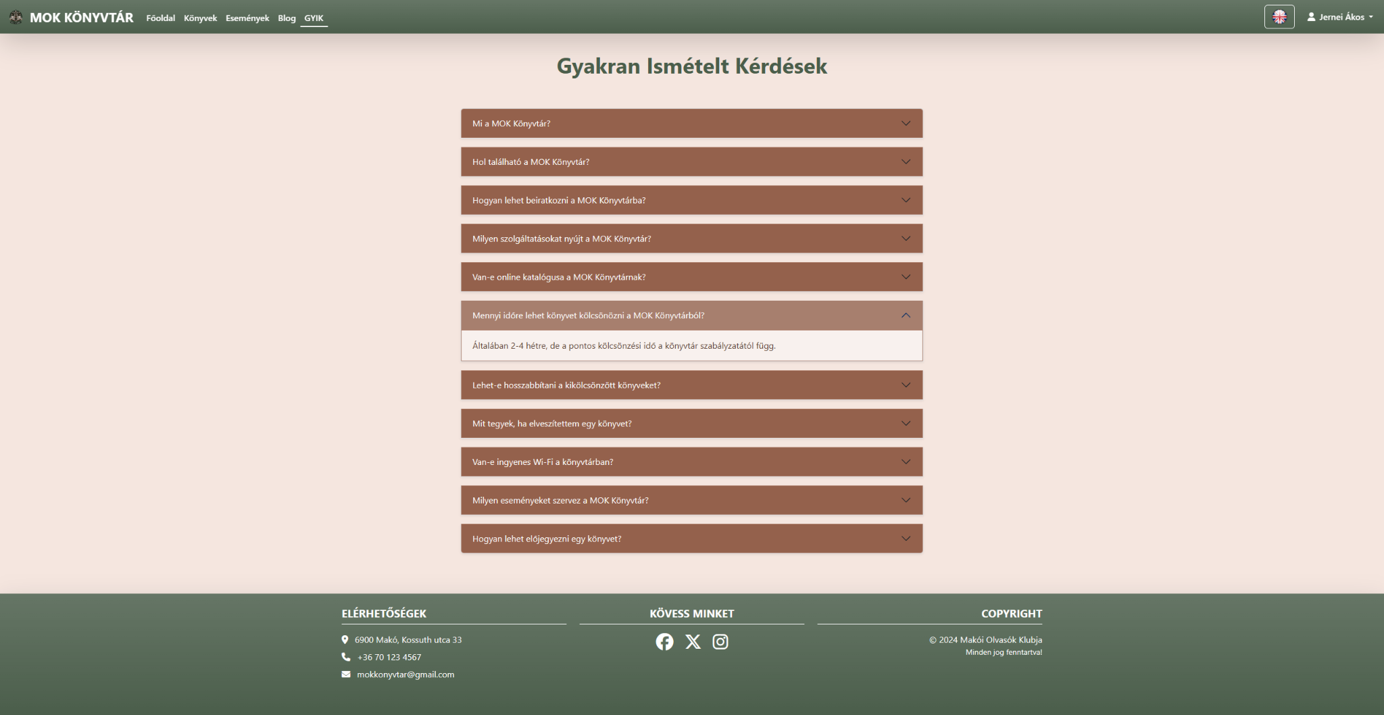
FAQ page
The Frequently Asked Questions page, as its name suggests, provides answers to frequently asked questions about the library.

Slide 7
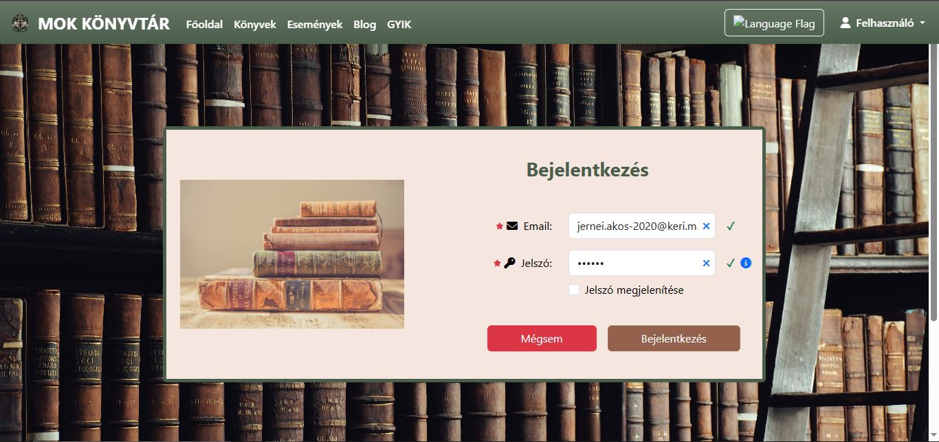
Login:
This page contains a required login page, if you want to rent a book. You need to write in your email address and your own password. With this you may have access to your profile page and your own cart.

Slide 8
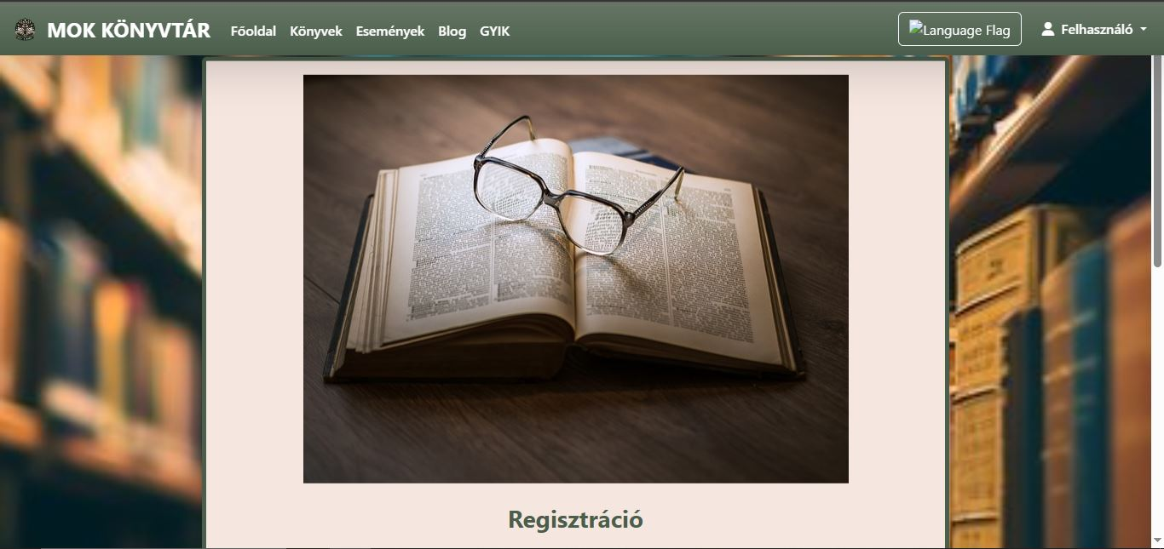
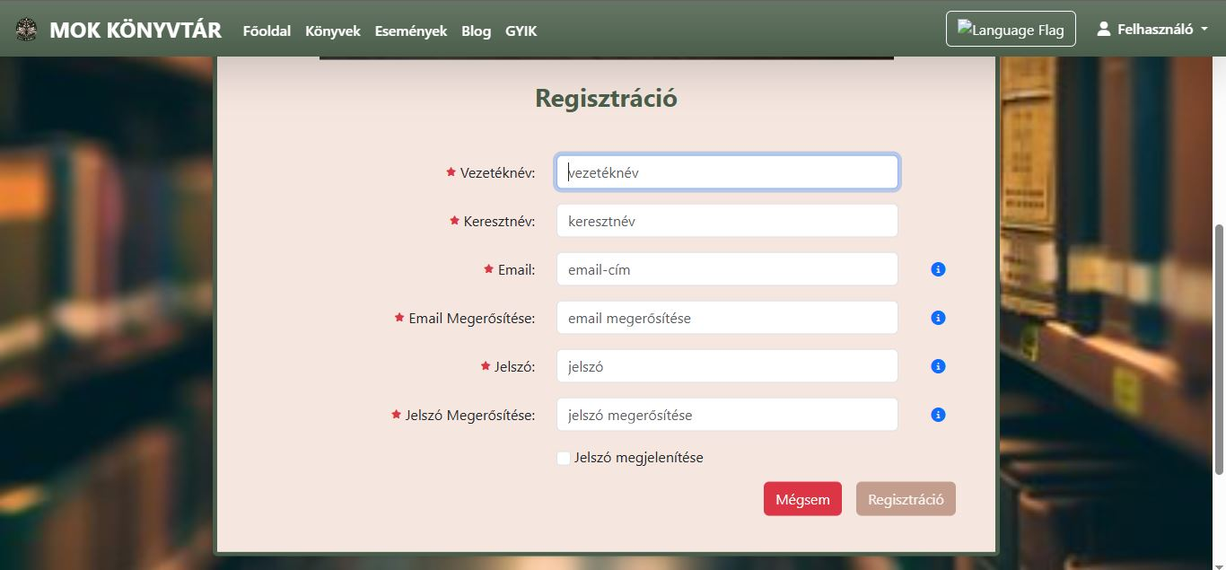
Registration:
If you don’t have your own profile for the library, you may have the chance to register on the website. You need to add your first and last name, your email and password, and both of these again for confirmation.

Slide 9
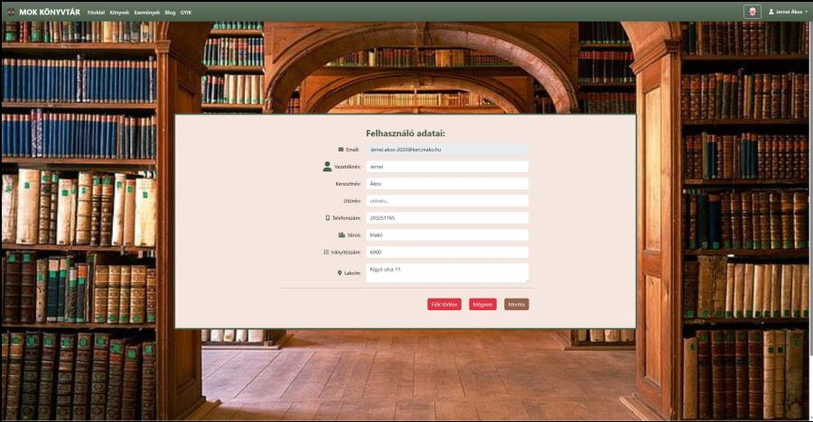
Profile:
In this page we access to our profile. Here you can modify your name, add your phone number, your postal code, the city you live in and your home address. You can also delete any information from your profile.

Slide 10
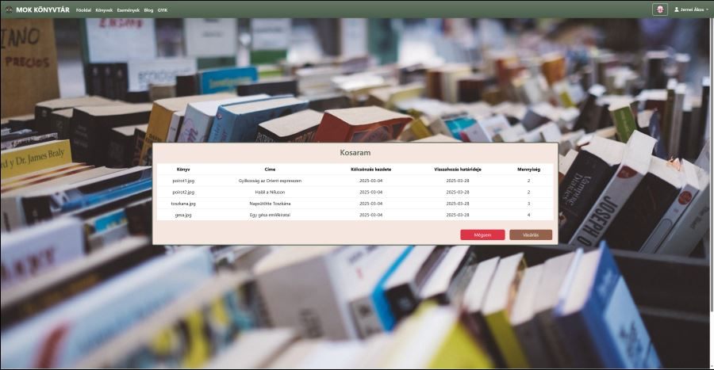
Cart:
This is the page where you can see all the books you chose to be rented. In the cart you can see the name of the book, when you rented it and when you need to return it, also the amount you ordered from each book. Renting is not functional at the moment, but the user can view the books which were chosen.

Slide 11
Summary
Our website is developing the digitisation of a library which could be useful for the next epidemic where users decide at home which book they want to borrow and only have to go to the library to pick it up. It also allows the library to communicate with readers.
We hope we have created something useful. Reading and its promotion is important, especially in today's world.
Thank you for your kind attention!

